Slide 1
Student E-Mail
By Brian Novick

Slide 2
Today…
Why use student e-mail?
Who has student e-mail?
How can you use student e-mail?
What issues can arise?
*Getting Started

Slide 3
Why use student e-mail?
The counterargument:
Kids don’t use e-mail.
Kids don’t want to use e-mail
The real world is using e-mail.
2.6 billion e-mail users
205 billion e-mails sent per day
122: The average business user sends 122 e-mails per day.

Slide 4
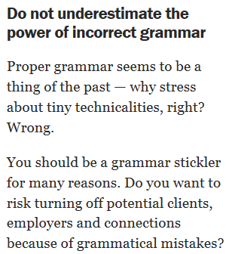
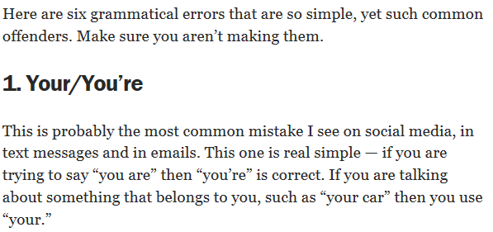
Why use student e-mail?

Slide 5
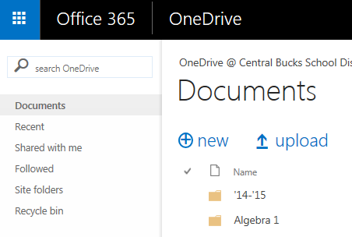
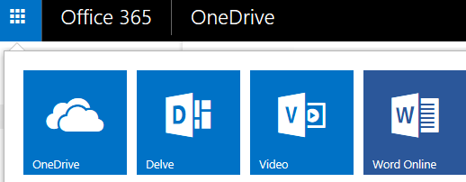
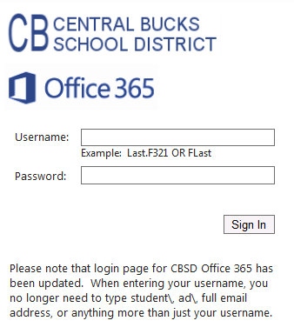
Who has student e-mail??
All student 5-12
Format: UserName.student.cbsd.org
Student can access their e-mail by visiting www.cbsd.org/365
Click “Outlook E-Mail”
Note: This will only work for students, not staff.
Click the blue button

Slide 6
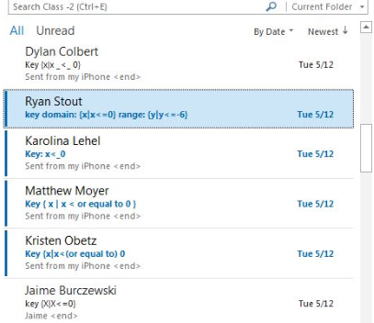
How can I use student e-mail in my classroom?
Distribute Information
Articles, enrichment activities or review guides
Web Site vs. E-Mail
Class Reminders
Submitting Work
Formative Assessment

Slide 7
What issues can arise?
Cell Phones
Jason Jaffe has created two helpful resources:
Screencast: http://www.screencast.com/t/nMy3Myto5m
Hand-out: http://www.cbsd.org/cms/lib07/PA01916442/Centricity/Domain/581/Adding%20CBSD%20Email%20to%20iPhones.pdf
If students are having trouble, the teacher should contact the help desk.
Set-Up

Slide 8
Summary…
Why use student e-mail?
Who has student e-mail?
How can you use student e-mail?
What issues can arise?

Slide 9
How do I set up e-mail groups
My Demonstration
Jason Jaffe’s Screencast:http://www.screencast.com/t/ZVVEZTGIfW

Slide 10
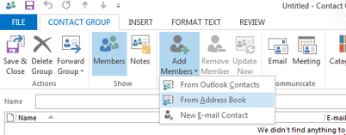

Slide 11
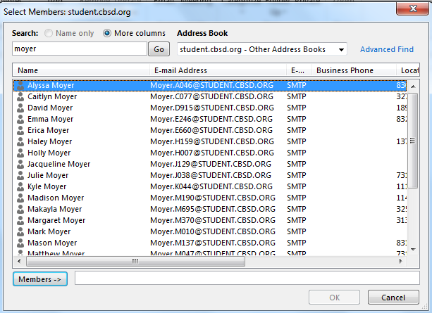
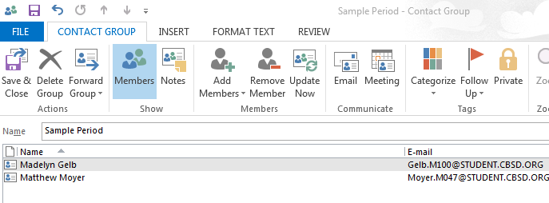

Slide 12
Today…
Why use student e-mail?
Who has student e-mail?
How can you use student e-mail?
What issues can arise?
*Getting Started

